Slide 1



Solving Optimal Arborescence using Chu-Liu-Edmonds’ Algorithm
Course Project- Algorithm Design and analysis
Course instructor- Dr. Apurav mudgal

Slide 2
CS302-ADA project by
Ihita Sinha (2021csb1095)
Rhitvik Anand (2021csb1127)
Anshika (2021csb1069)
Mohit Kumar Bhuria (2021csb1109)
Shashank Kumar (2021csb1131)

Slide 3
Arborescence of a graph
Definition 1:
An arborescence of G (with respect to r) is a directed spanning tree rooted at r.
Definition 2:
Subgraph T = (V, F) of G is an arborescence with respect to root r if and only if T has no cycles, and for each node v ≠ r, there is exactly one edge in F that enters v.
NOTE: Definition 1 is equivalent to Definition 2

Slide 4

THE PROBLEM
Every directed graph G, where every node is reachable from root r, will have an arborescence rooted at r.
Cost of an arborescence is the sum of all edges involved in that arborescence.
Aim:
Given a connected graph, find its min-cost (optimal) arborescence

Slide 5
INTITUTION-1
It is not necessary that the lowest cost edge be a part of the minimum arborescence ⇒ Basic greedy approach will not work.
Explanation:
lowest cost edge may be going into r, in which case it cannot be part of any arborescence.
even if lowest cost edge is in some arborescence, it might not be in the minimum arborescence.

Slide 6
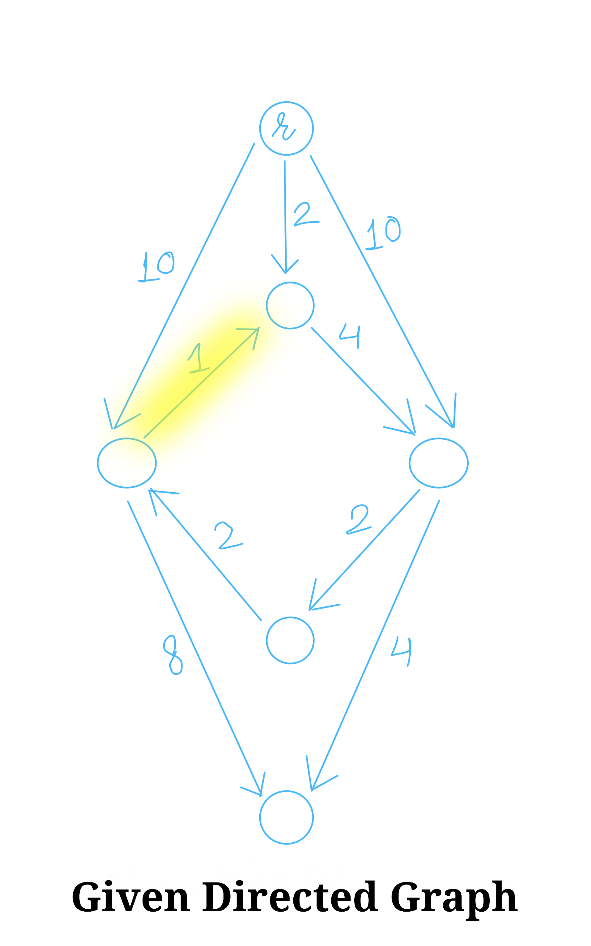
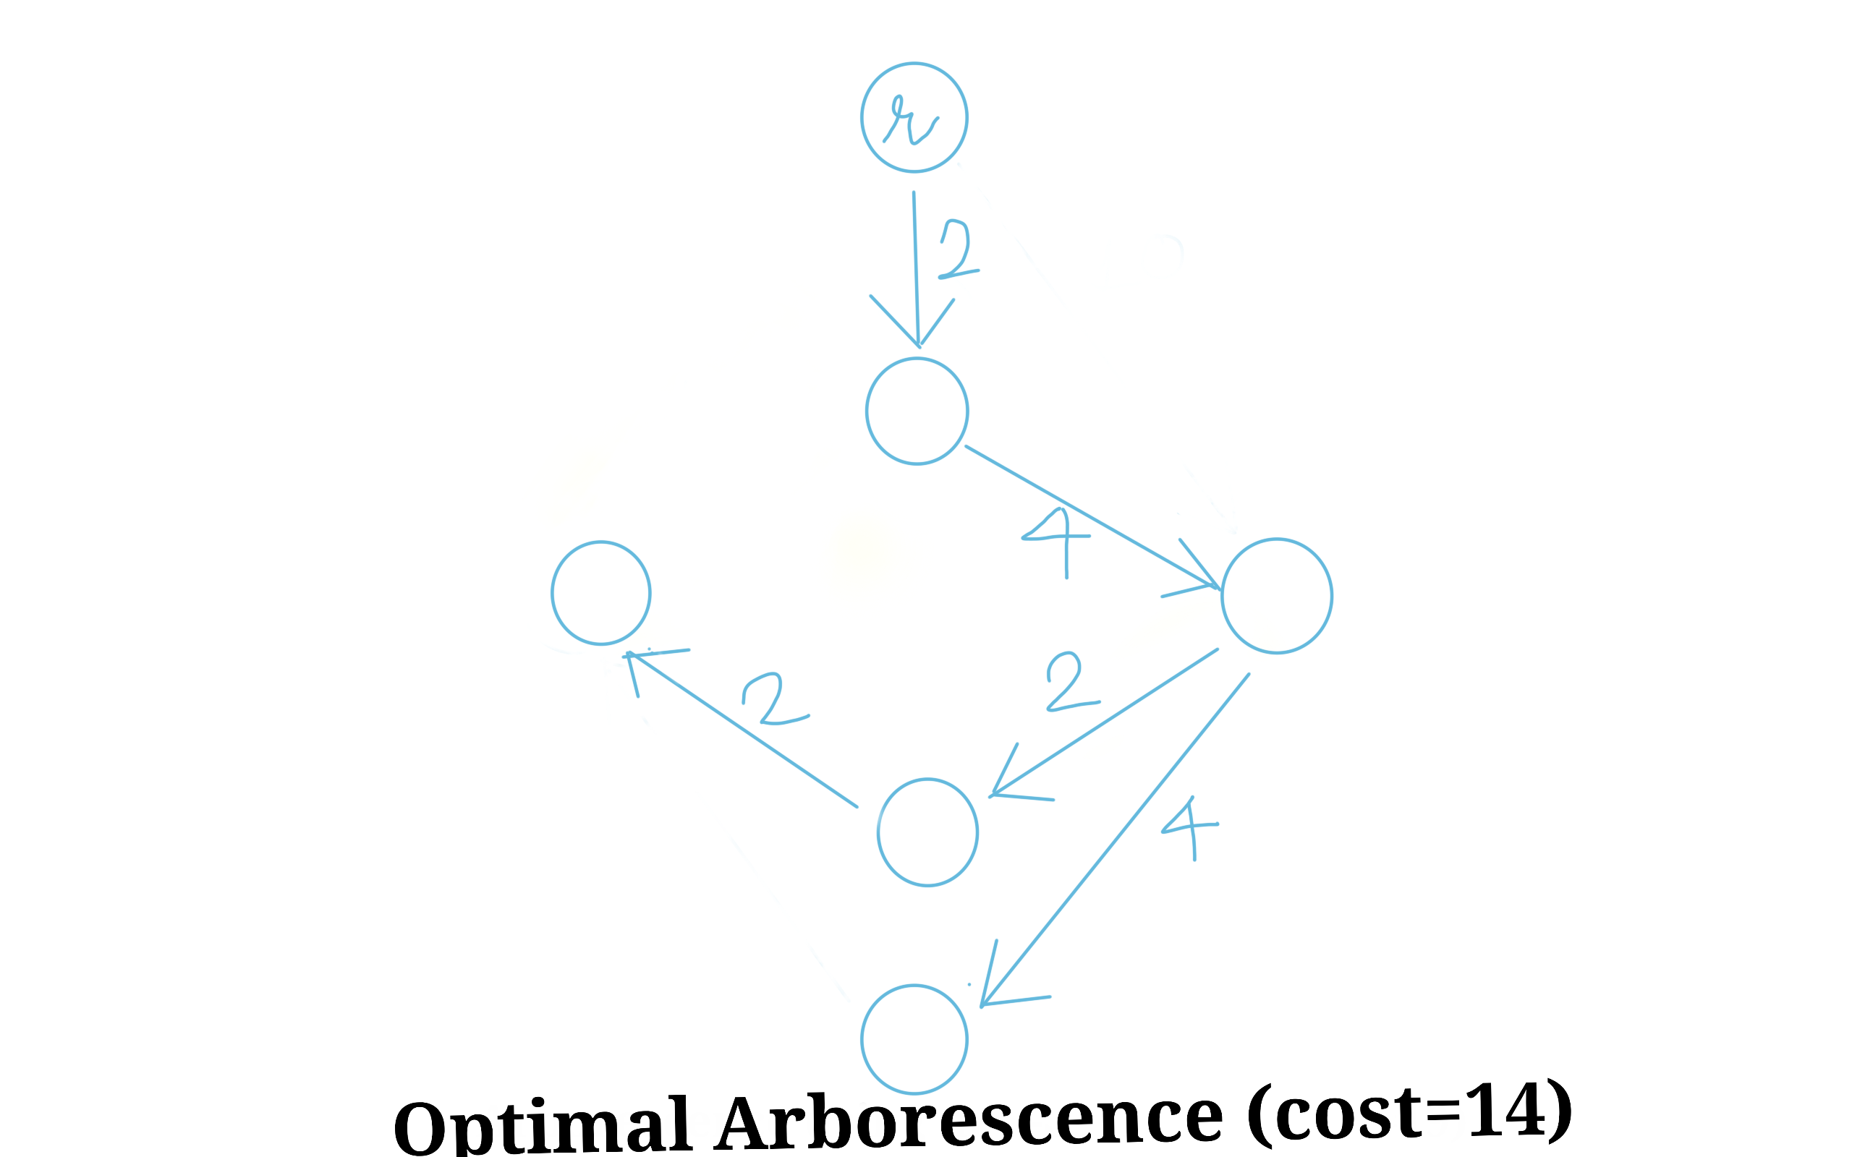
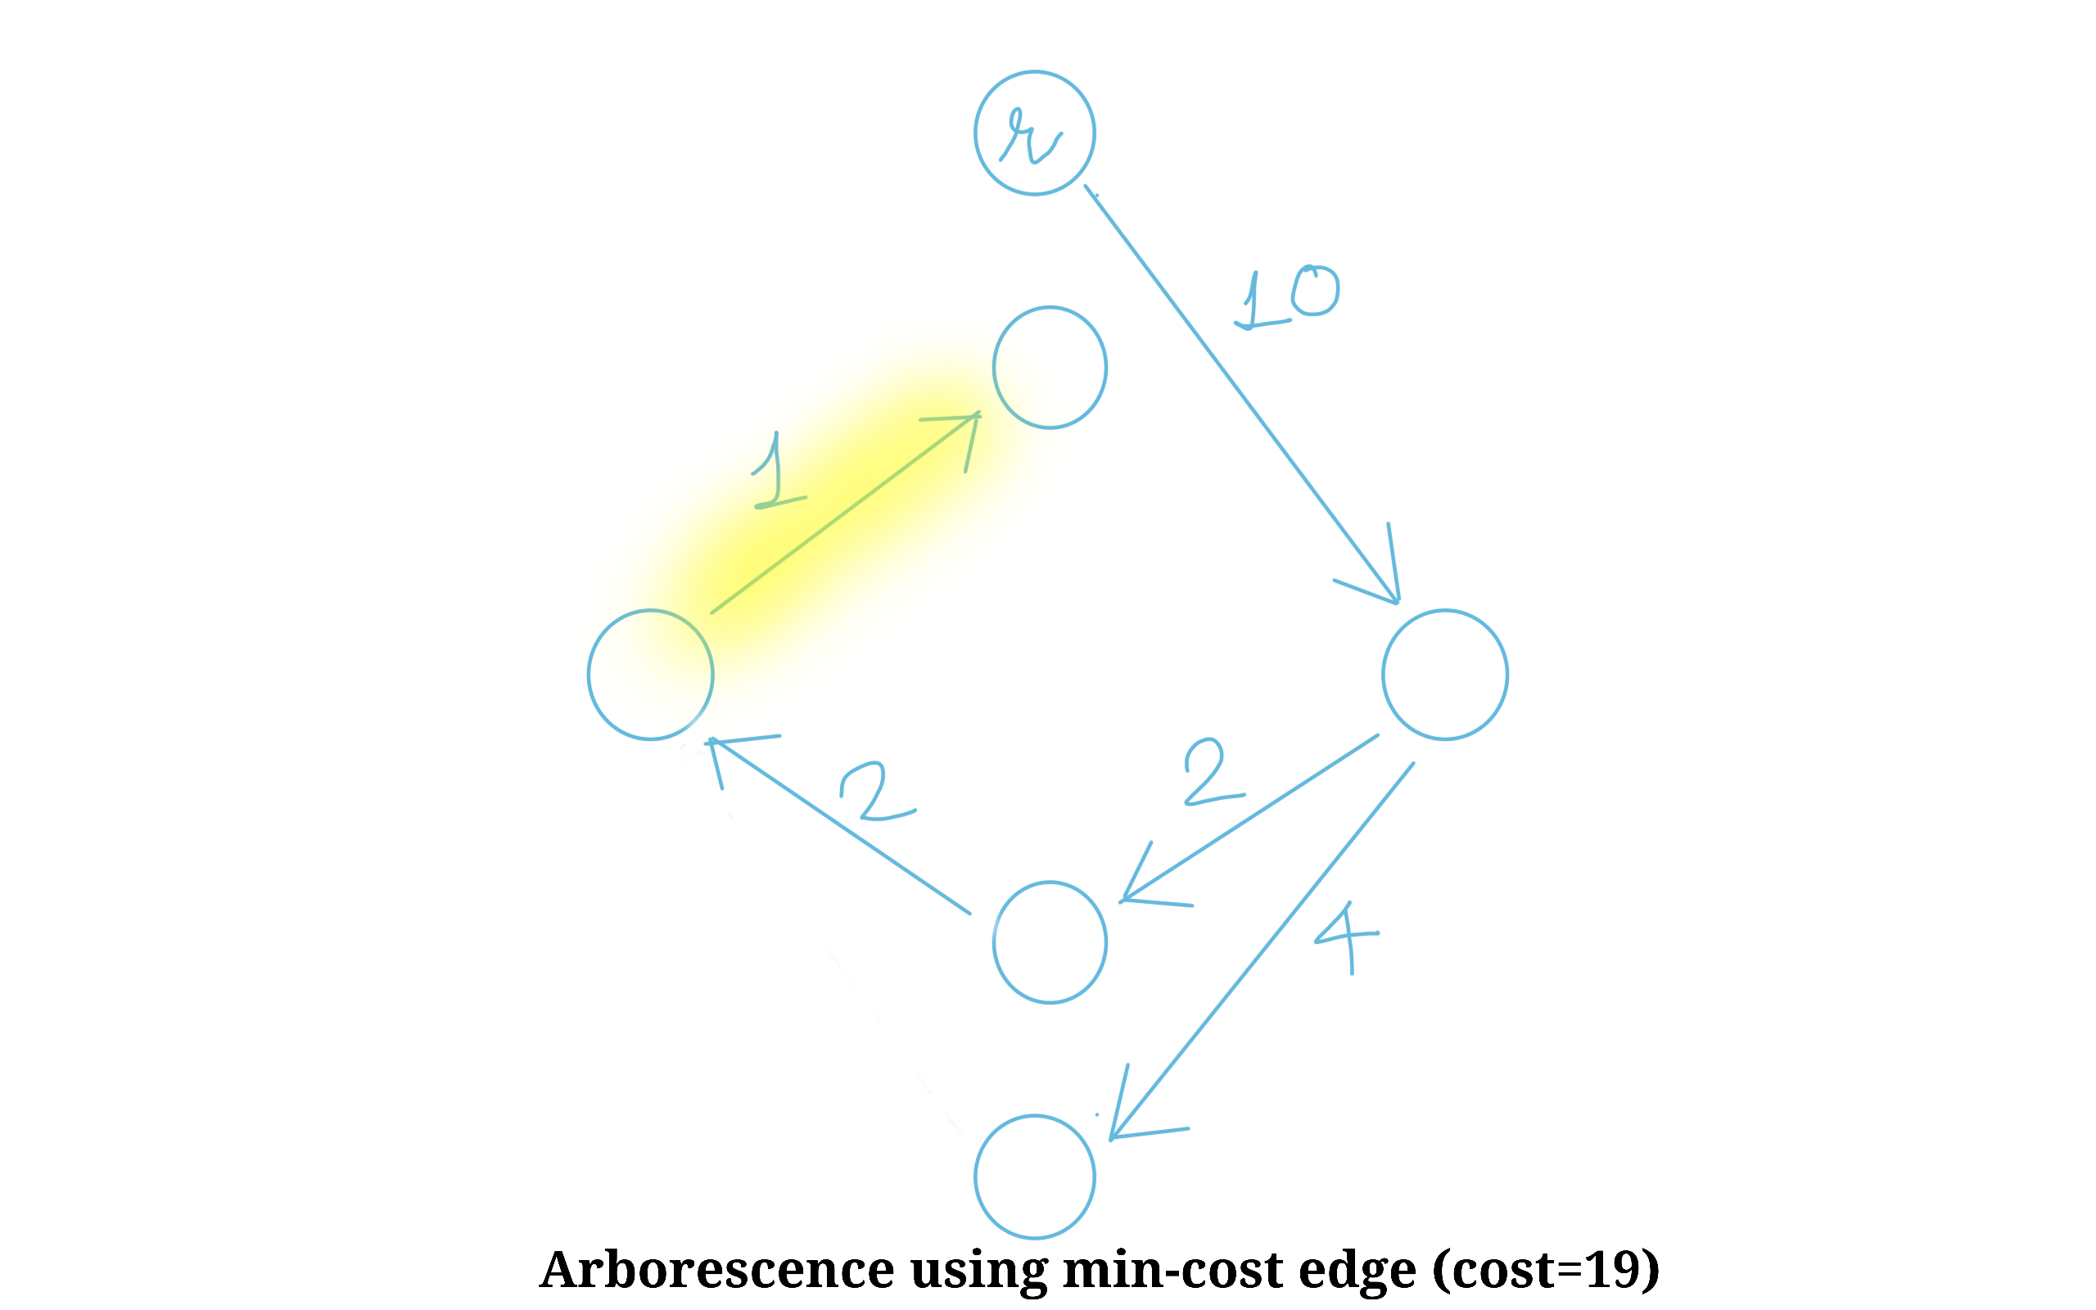

Slide 7
INTITUTION-2
We know that for every vertex v ≠ r, there will be exactly one edge incoming to v in arborescence. For r, there will be no incoming edge. Thus, we observe that any arborescence will contain n-1 edges, where n = no. of vertices.
Suppose we create array F* = { (u, v) | c(u, v) is min of all c(x, v) ; where (x, v) is an existing edge }. Here, |F*| =n-1
Claim: If this F* is an arborescence, then it is an optimal arborescence.

Slide 8
Two Possible cases:
CASE 1→ F* is an arborescence:
Since F* is an arborescence, there is exactly one edge coming into v (∀ v ≠ r).
By definition of F*, all these edges are the ones with minimum possible cost.
⇒ The total cost of F* must be the minimum possible while still being an arborescence.
⇒ F* is an optimal arborescence.
If F* is an arborescence: We are done.
Return F*
CASE 2→ F* is not an arborescence:
Note that, if T is an arborescence, 1. T has no cycles. 2. For each node v ≠ r, there is exactly one edge in T that enters v.
By definition of F*, we know that condition 2 for arborescence stands true.
Since F* is not an arborescence and satisfies condition 2, it must not satisfy condition 1.
⇒ F* has a cycle.
If F* is an arborescence:
What to do with Cycle?

Slide 9
Step 1
Claim 1
T is optimal arborescence on graph G, root r with weight function w
⇕
T is optimal arborescence on graph G, root r with weight function w’
Suppose the current weight function is w : E → R⁺, such that w(u, v) = weight of edge (u, v)
Define y : V → R⁺, such that y(v) = min_{(u, v) ∈ E} (w(u, v))
Define w’ : E → R⁺, such that w’(u, v) = w(u, v) - y(v)

Slide 10
Step 2a
We now decide to find optimal arborescence on graph G, with root r, with weight function w’.
Observation 1- All edges in F* now have weight 0.
Observation 2- All edges involved in the cycle thus have weight 0.
Intuition- If we find an optimal arborescence, we can use as many edges form the cycle as we want, as using them does not increase cost. (weight = 0.)
We can thus consider the cycle as a “supernode” - ignoring the edges involved in the cycle, to find an optimal arborescence.

Slide 11
Step 2B
Define graph G’(V’, E’) from G(V, E) such that 1. V’ = V - {nodes in cycle} ∪ {supernode n*} 2. E’ is such that, ∀ (u, v) ∈ E,
If (u, v) is an incoming edge to cycle, (u, n*) ∈ E’ AND w’_{G’}(u, n*) = min_{(u, v) is incoming to cycle} (w’_{G}(u, v))
If (u, v) is an outgoing edge for cycle (n*, v) ∈ E’ AND w’_{G’}(n*, v) = min_{(u, v) is outgoing for cycle} (w’_{G}(u, v))
If (u, v) is an external edge to cycle (u, v) ∈ E’ AND w’_{G’}(u, v) = w’_{G}(u, v)

Slide 12
Step 3
Claim 1
This arborescence T, (obtained by extending T’ by including all edges from cycle except for one), is the optimal arborescence for graph G(V, E).
We now recursively find T’ = optimal arborescence of graph G’(V’, E’) with w’G’
Extend T’ to an arborescence T by adding all but one edge from the cycle in F*.
Return T.

Slide 13
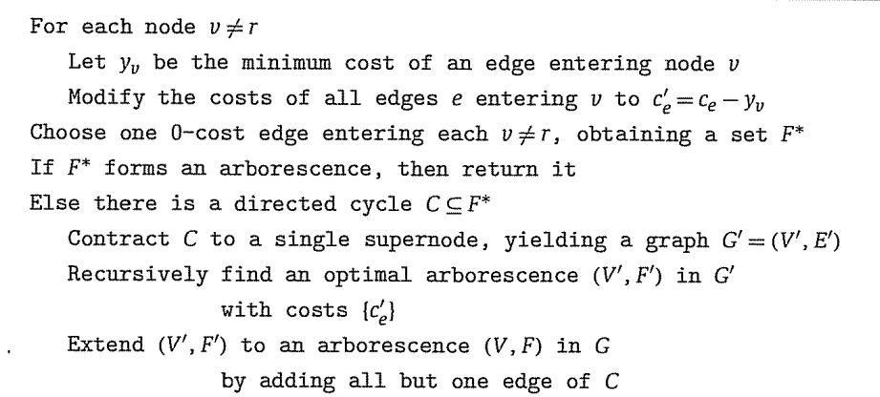
pSEUDOCODE FOR ALGORITHM

Slide 14
RUN TIME ANALYSIS
The running time of this algorithm is O(EV ). A faster implementation of the algorithm due to Robert
Tarjan runs in time O(E log V ) for sparse graphs and O(V 2) for dense graphs.
This is as fast as Prim’s algorithm for an undirected minimum spanning tree.
In 1986, Gabow, Galil, Spencer, and Tarjan produced a faster implementation, with running time
O(E + V log V )

Slide 15
APPLICATIONS

Slide 16
REFERENCES
[1] Frederick Bock. An algorithm to construct a minimum directed spanning tree in a directed network. Developments in operations research, pages 29–44, 1971.
[2] Yoeng-jin Chu and Tseng-hong Liu. On the shortest arborescence of a directed graph. Sci. Sinica,14:1396–1400, 1965.Solving Optimal Arborescence using Chu-Liu-Edmonds’ Algorithm
[3] Jack Edmonds. Optimum branchings. J. Res. Nat. Bur. Standards Sect. B, 71B:233–240, 1967.
[4] H. N. Gabow, Z. Galil, T. Spencer, and R. E. Tarjan. Efficient algorithms for finding minimum spanning trees in undirected and directed graphs. Combinatorica, 6(2):109–122, 1986. Theory of computing (Singer Island, Fla., 1984).25–35, 1977.

Slide 17
REFERENCES
[5] R. M. Karp. A simple derivation of Edmonds’ algorithm for optimum branching. Networks, 1:265–272,
1971/72.
[6] R. E. Tarjan. Finding optimum branchings. Networks, 7(1):25–35, 1977.

